Slide 1

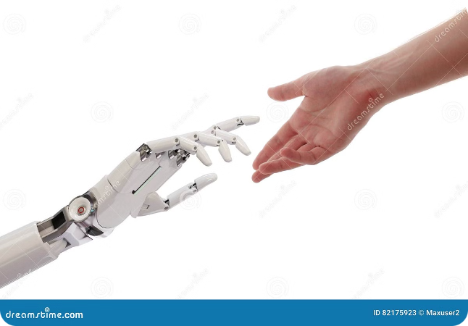
National AI Day
A celebration of AI's advancements and impacts on our world.

Slide 2

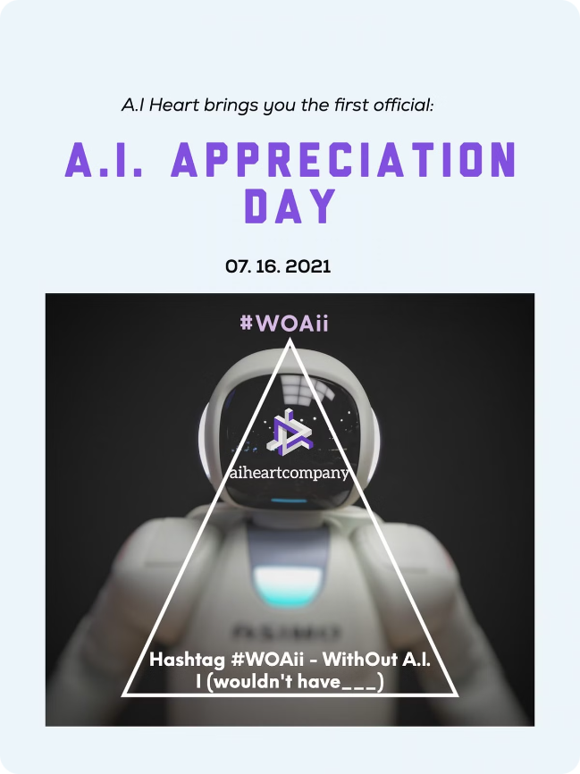
What is National AI Day?
National AI Day is an annual event that recognizes the transformative power of artificial intelligence. It's a chance to explore the latest AI innovations, learn about the technology's applications, and discuss the ethical considerations surrounding its development.
AI Innovations
Global Impact
This day highlights advancements in AI, such as machine learning, natural language processing, and computer vision.
National AI Day sheds light on the widespread impact of AI across various industries, from healthcare to finance.
Future Prospects
It provides an opportunity to discuss the future potential of AI and its role in shaping our society.

Slide 3

The Importance of AI Technology
AI technology has become increasingly crucial in various aspects of our lives. From improving healthcare outcomes to enhancing customer experiences, AI plays a significant role in advancing various industries.
1
Data Analysis
2
Automation
AI can analyze vast amounts of data to identify patterns and insights that would be impossible for humans to discern.
AI can automate repetitive tasks, freeing up human workers to focus on more creative and strategic endeavors.
3
Problem Solving
4
Personalization
AI algorithms can be trained to solve complex problems in areas such as medical diagnostics and financial forecasting.
AI can personalize experiences, such as providing tailored recommendations for products and services.

Slide 4

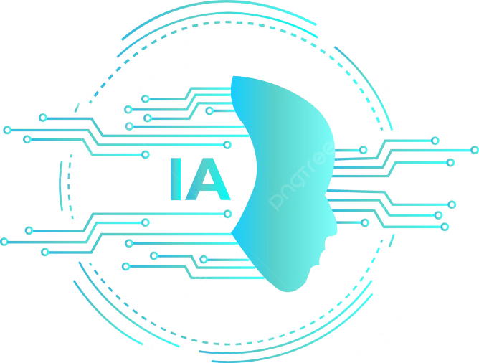
Advancements in AI
The field of AI is constantly evolving, with breakthroughs happening at an unprecedented pace. These advancements are pushing the boundaries of what AI can achieve and opening up new possibilities for its applications.
1
Deep Learning
Deep learning algorithms have revolutionized AI, enabling machines to learn from large datasets and improve their performance over time.
2
Natural Language Processing (NLP)
NLP advancements allow machines to understand and process human language, enabling AI-powered chatbots and voice assistants.
3
Computer Vision
Computer vision algorithms enable machines to "see" and interpret images, leading to advancements in facial recognition and autonomous driving.
4
AI Ethics
Increasing focus on ethical considerations surrounding AI, ensuring responsible development and deployment of the technology.

Slide 5
AI's Impact on Society
AI is having a profound impact on various aspects of our society, transforming how we live, work, and interact with the world around us.
Job Market
Healthcare
Education
AI is automating tasks and creating new job opportunities in fields like data science and AI engineering.
AI is used for disease diagnosis, drug discovery, and personalized treatment plans, improving patient care.
AI is being used to personalize learning experiences, provide intelligent tutoring systems, and automate administrative tasks.
Data Scientist
AI Engineer
AI Researcher

Slide 6

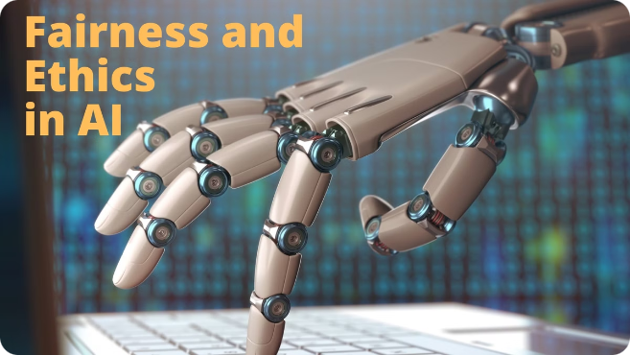



Challenges and Ethical Considerations
Along with its immense potential, AI also presents challenges and ethical considerations that need to be addressed. Ensuring responsible and equitable development and use of AI is crucial.
Bias and Fairness
AI algorithms can reflect biases present in the data they are trained on, leading to unfair outcomes.
Privacy and Security
AI systems collect vast amounts of personal data, raising concerns about privacy and security.
Job Displacement
AI automation could lead to job displacement in certain sectors, requiring efforts to reskill and upskill workers.

Slide 7

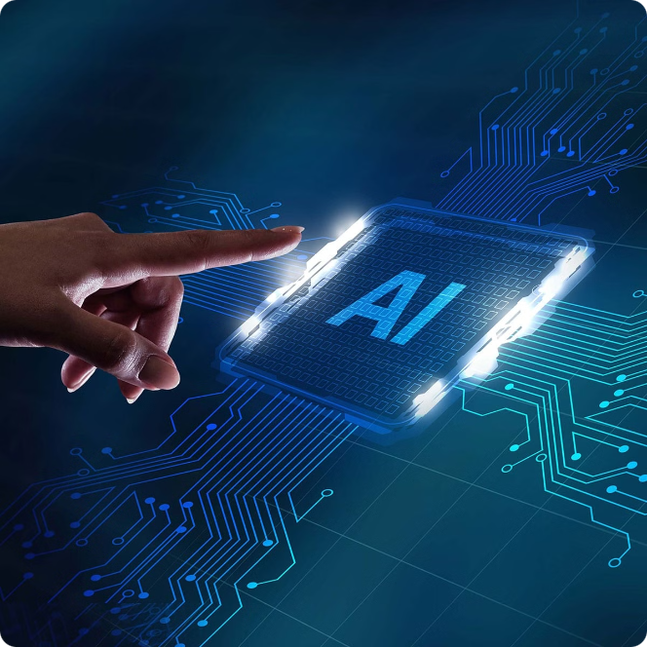




Celebrating National AI Day
National AI Day is an opportunity to celebrate the advancements in AI and its potential to improve our lives. It's a chance to learn about AI, engage in discussions about its ethical implications, and explore the future of this transformative technology.
Educational Events
Public Forums
Many institutions and organizations host workshops, seminars, and conferences to educate the public about AI.
Discussions and debates on the ethical and societal implications of AI are encouraged on this day.
Awards and Recognition
AI Demonstrations
National AI Day recognizes individuals and organizations making significant contributions to the field of AI.
Live demonstrations showcase the latest AI applications and their real-world impact.

Slide 8

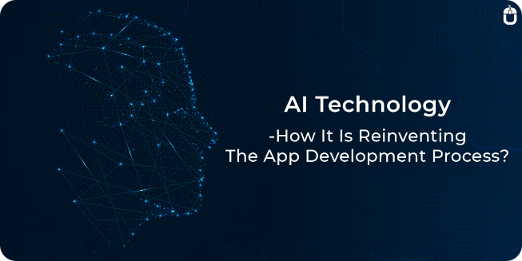
Get Involved in National AI Day
There are many ways to get involved in National AI Day and contribute to the growth and responsible development of AI.
Attend Events
Participate in workshops, conferences, and seminars focused on AI.
Volunteer
Contribute to organizations promoting AI education and research.
Share Your Knowledge
Educate others about AI and its impact on society.
Support AI Research
Donate to organizations dedicated to advancing AI research.

Slide 9
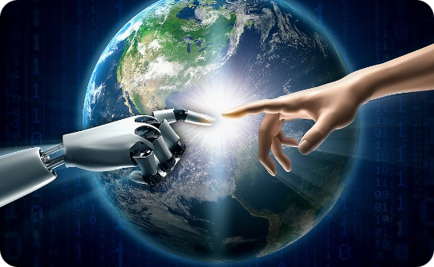


The Future of AI
AI is rapidly evolving and its impact on our world will continue to grow. It's important to embrace AI's potential while addressing its challenges, ensuring a future where AI benefits all of humanity.
AI-Powered Healthcare
Autonomous Transportation
Personalized Education
AI will revolutionize healthcare, leading to faster diagnoses, personalized treatments, and improved patient outcomes.
AI will create personalized learning experiences, tailored to individual students' needs and abilities.
AI will power self-driving cars, drones, and other autonomous vehicles, transforming transportation.

Slide 10

Thank you

